Slide 1

To-Do App TASK ZEN
Capstone Project Wave - 44

Slide 2
Mohd. Adnan
Lalit Reddy
Pratuysh Kumar
Task - Zen Team -

Slide 3

WHY ?

Slide 4

INTRODUCTION :
A to-do is a simple list of tasks that follows you to visually see what you need to accomplish.
You can use a to-do tracker as a tool to manage your to-do lists and tasks.
You can normally create and organise tasks, set deadlines, and prioritise items using to-do trackers.
Whether you're handling personal or professional projects, a to-do tracker may be a really helpful tool for remaining organised and productive.

Slide 5



To-Do Functionality:
Add Task
Enter the task details in the intuitive task input field. Include a title, description, due date, and assign a priority level.
Update Task
Click on "Edit" option to open the task its details.
Important
Apply the chosen option to mark the task as important. The task will now stand out in your important list, making it easily recognizable and ensuring that you prioritize it accordingly.
Update the necessary information for the task. You can modify the description, due date, priority.

Slide 6




Continue :
Archive
Archiving tasks helps declutter your task list by moving completed task. This allows you to focus on your current and upcoming tasks while still maintaining access to archived tasks for future reference.
Complete
Marking tasks as complete helps you track your progress and maintain an organized task list. By visually differentiating completed tasks, you can focus on the remaining active tasks and have a clear overview of your accomplishments..
Delete
Deleting tasks allows you to remove unnecessary or completed tasks from your task list, keeping it organized and focused on your active and relevant tasks.
Notification
Setting notifications for tasks helps you stay informed and on track.

Slide 7
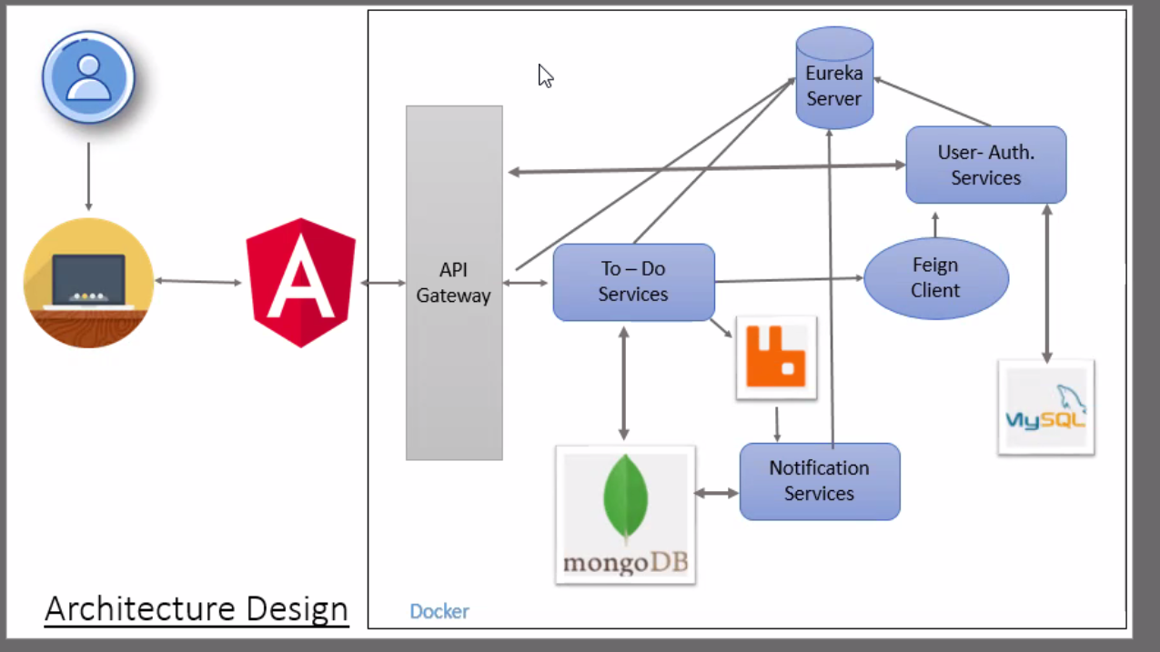
Architecture Design :

Slide 8





Technology used :
HTML
CSS
FRONT END
TYPESCRIPT
ANGULAR
ANGULAR MATERIAL

Slide 9


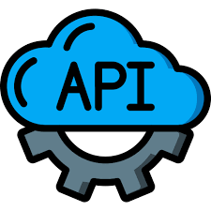


Continue :
Spring- Boot
MICRO - SERVICES
BACK-END
API GATEWAY
EUREKA SERVER
Rabbit MQ

Slide 10


Continue :
MONGO DB
DATA-BASE
MY SQL

Slide 11
Project Showcase :
Registration and Login
Creating and Managing Tasks
Setting Priorities and Due Dates
Search Task and Filter Task
Complete and Archive Task
Notifications

Slide 12
Advantages :
Increases productivity
Improves your task management
Set deadlines for each goal
Prioritize your goals
Time Management
Goal Alignment

Slide 13
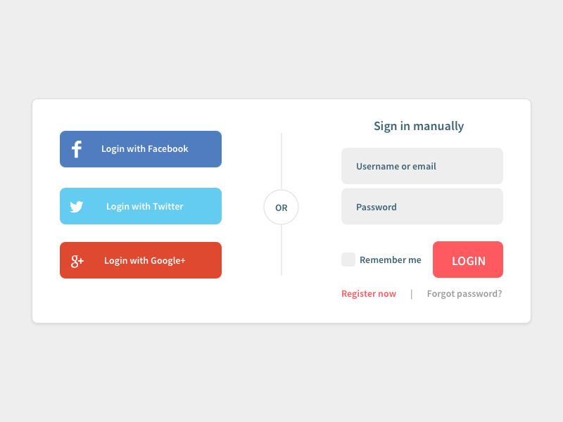
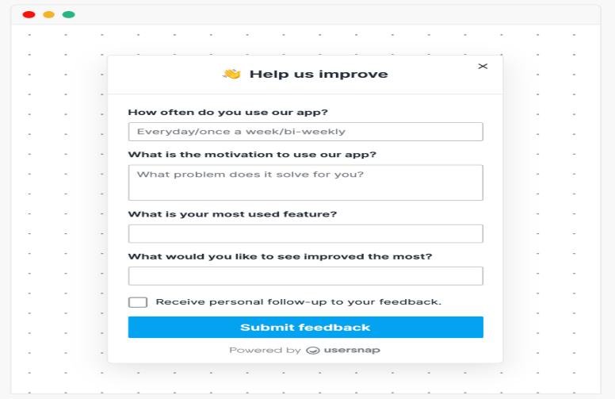
Future Enhancement :
To provide better ui for the users
To make login using gmail and facebook
Better notification system to keep track of tasks
To take the feedback from the users directly
Reminder mail to be sent a day before the due date.

Slide 14


Slide 15


